Slide 1


Hafizah Abdul Wahid
19 September 2024

Slide 2
Outline
Executive Summary
Introduction
Methodology
Results
Conclusion
Appendix

Slide 3
Executive Summary
In this presentation I am investigating what are the key factors that influence the landing outcomes of SpaceX’s Falcon 9 launches, and creating a model that will predict the outcomes of future launches.
The dataset is collected from the SpaceX API as well as webscraping. Data analysis is done using visualization, SQL, Folium, and Plotly Dash, the results of which then inform a predictive classification model.
Summary of Results
Key factors identified in the successful landing of a launch are Flight Number, Booster Version, Orbit Type, and Payload Mass. The predictive models identified as the most suitable are Logistic Regression, SVM and KNN.

Slide 4
Introduction
SpaceX advertises Falcon 9 rocket launches on its website with a cost of 62 million dollars; other providers cost upward of 165 million dollars each. Much of the savings is because SpaceX can reuse the first stage of their launches.
Therefore if we can determine if the first stage will land, we can determine the cost of a launch.
This information can be used if an alternate company wants to bid against SpaceX for a rocket launch.

Slide 5

Section 1

Slide 6
Methodology
Executive Summary
Data collection methodology:
Using SpaceX’s API and Webscraping
Perform data wrangling
Further classify data into successful and unsuccessful landings
Perform exploratory data analysis (EDA) using visualization and SQL
Perform interactive visual analytics using Folium and Plotly Dash
Perform predictive analysis using classification models
Using Logistic Regression, SVM, Decision Tree and KNN

Slide 7
Data Collection
Data was collected in two ways:
Using the SpaceX API
Webscraping

Slide 8
Data Collection – SpaceX API
SpaceX API
GET request
Normalize json
Data collection via SpaceX API was done in two steps:
Data harvesting using GET
Parsing launch data for only useful features to create a new dataframe, which is later filtered for Falcon 9 launches only
Github URL:
https://github.com/hafizah-aw/IBM-SpaceX-Capstone-Project/blob/e713de2ba7bcb59417243ed92af6677baa6cdb87/jupyter-labs-spacex-data-collection-api.ipynb
SpaceX API
GET request for useful features based on ID tags
Data on rocket, payloads, launchpad, and cores

Slide 9
Data Collection - Scraping
Data collection via Webscraping was done in two steps:
Using BeautifulSoup to extract Falcon 9 launch data from Wikipedia
Parsing the data and converting it into a dataframe
GitHub URL:
https://github.com/hafizah-aw/IBM-SpaceX-Capstone-Project/blob/b2d9673d65b63dfbd67c7fa4c39ba62b2b21c168/jupyter-labs-webscraping.ipynb
Wikipedia page
HTML GET request
BeautifulSoup
Extract relevant launch tables and associated data

Slide 10
Data Wrangling
Landing Outcomes
True ASDS
True RTLS
True Ocean
None None
False RTLS
False ASDS
False Ocean
None ASDS
Unsuccessful
Successful
The launch data was further processed to identify the types of landing outcomes.
These were further classified as “successful” or “unsuccessful”.
GitHub URL:
https://github.com/hafizah-aw/IBM-SpaceX-Capstone-Project/blob/b2d9673d65b63dfbd67c7fa4c39ba62b2b21c168/labs-jupyter-spacex-Data%20wrangling.ipynb

Slide 11
EDA with Data Visualization
In exploratory analysis of the data, the following charts were used to find out how different variables affected the success rate of a launch:
Scatter point chart, to visualize the relationships between selected variables
Bar chart, to visualize the success rate for a chosen variable
Line chart, to visualize the any trends in successful landings
GitHub URL:
https://github.com/hafizah-aw/IBM-SpaceX-Capstone-Project/blob/b2d9673d65b63dfbd67c7fa4c39ba62b2b21c168/edadataviz.ipynb

Slide 12
EDA with SQL
These are the SQL queries I’ve performed:
Display the names of the unique launch sites in the space mission
Display 5 records where launch sites begin with the string 'CCA'
Display the total payload mass carried by boosters launched by NASA (CRS)
Display average payload mass carried by booster version F9 v1.1
List the date when the first successful landing outcome in ground pad was achieved
List the names of the boosters which have success in drone ship and have payload mass greater than 4000 but less than 6000

Slide 13
EDA with SQL
These are the SQL queries I’ve performed:
List the total number of successful and failure mission outcomes
List the names of the booster_versions which have carried the maximum payload mass using a subquery
List the records which will display the month names, failure landing_outcomes in drone ship ,booster versions, launch_site for the months in year 2015
Rank the count of landing outcomes (such as Failure (drone ship) or Success (ground pad)) between the date 2010-06-04 and 2017-03-20, in descending order
GitHub URL:
https://github.com/hafizah-aw/IBM-SpaceX-Capstone-Project/blob/b2d9673d65b63dfbd67c7fa4c39ba62b2b21c168/jupyter-labs-eda-sql-coursera_sqllite.ipynb

Slide 14
Build an Interactive Map with Folium
To the interactive map, I added:
Circles to represent each of the SpaceX launch sites
Marker clusters to show the number of successful and unsuccessful landings at each of these sites
Polylines with distance between launch sites and nearby areas of interest such as coastlines, railways, airports, etc.
On the map, these objects can immediately tell you how often a launch site is used, its landing success rate, and possible reasons for the site location with respect to natural and built features of the surrounding area.
GitHub URL
https://github.com/hafizah-aw/IBM-SpaceX-Capstone-Project/blob/b2d9673d65b63dfbd67c7fa4c39ba62b2b21c168/lab_jupyter_launch_site_location%20(1).ipynb

Slide 15
Build a Dashboard with Plotly Dash
For my dashboard, I have added:
A Launch Site Drop-down Input Component
A callback function to render success-pie-chart based on selected site dropdown
A Range Slider to Select Payload
A callback function to render the success-payload-scatter-chart scatter plot
These plots and interactions can tell you:
Which of the sites is most successful and the success rate of each site
The highest performing payload range and booster version
GitHub URL
https://github.com/hafizah-aw/IBM-SpaceX-Capstone-Project/blob/b2d9673d65b63dfbd67c7fa4c39ba62b2b21c168/spacex_dash_app.py

Slide 16
Predictive Analysis (Classification)
To find the best performing classification model, the following steps were employed:
Standardize data
Split data into training and testing data
Run GridSearchCV with selected model on training data
Evaluate accuracy on test data
Plot a confusion matrix
Iterate the same process for other models
GitHub URL
https://github.com/hafizah-aw/IBM-SpaceX-Capstone-Project/blob/b2d9673d65b63dfbd67c7fa4c39ba62b2b21c168/SpaceX_Machine%20Learning%20Prediction_Part_5%20(4).ipynb
Standardize Data
train_test_split
Run GridSearchCV with model on training data
Evaluate accuracy on testing data
Plot confusion matrix
Repeat with other models

Slide 17
Results
Exploratory data analysis results
Interactive analytics demo in screenshots
Predictive analysis results

Slide 18

Section 2

Slide 19
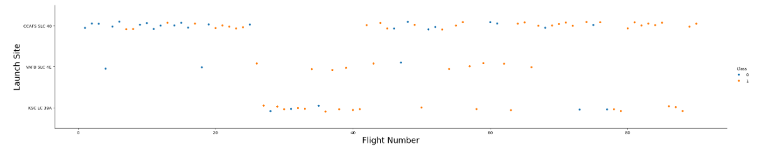
Flight Number vs. Launch Site
Scatter plot of Flight Number vs. Launch Site
Analysis – we can see that CCAFS SLC 40 seems to be a preferred launch site with the highest number of launches, although the launch sites themselves do not appear to be much of a factor in the success rate of launches.

Slide 20
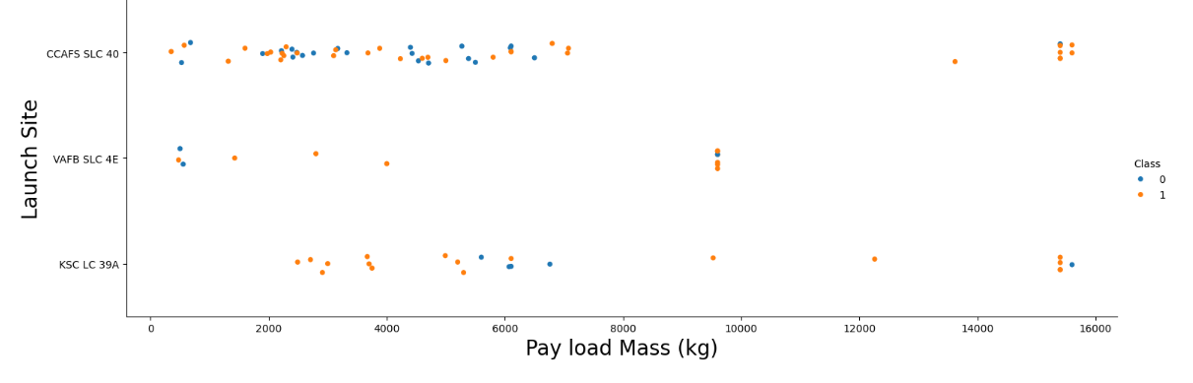
Payload vs. Launch Site
Scatter plot of Payload vs. Launch Site
Analysis – there has been no launches from VAFB SLC 4E with payloads above 10000 kg. Payload or Launch Site do not seem to influence success rate.

Slide 21
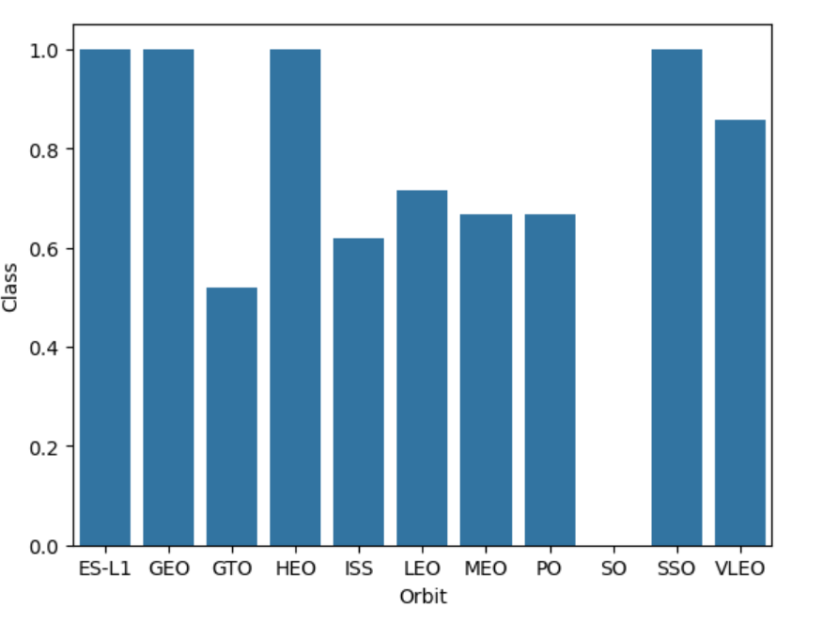
Success Rate vs. Orbit Type
Bar chart for the success rate of each orbit type
Analysis – all launches for ES-L1, GEO, HEO and SSO orbits have been successful.

Slide 22
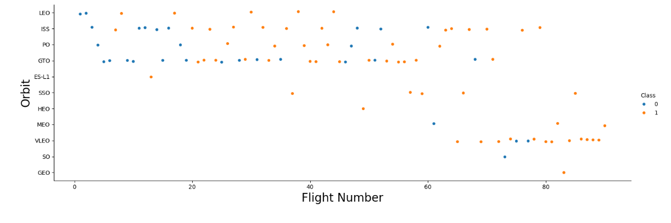
Flight Number vs. Orbit Type
Scatter point of Flight number vs. Orbit type
Analysis – it is clear that GEO, HEO, ES-L1 and SSO orbits have extremely high success rates because of low launch numbers. Flight number still appears to be a greater factor in success rate than orbit type.

Slide 23
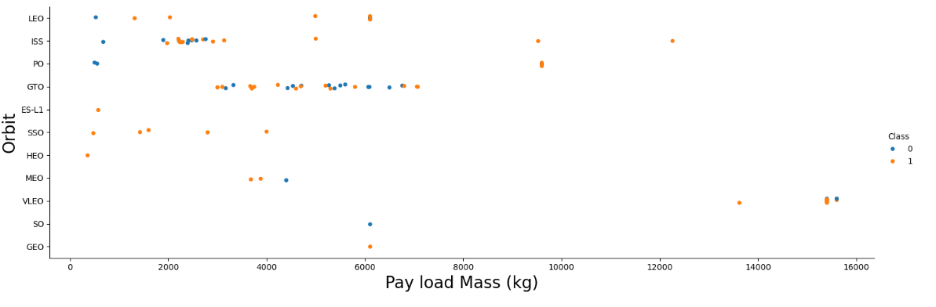
Payload vs. Orbit Type
Scatter point of Payload vs. Orbit type
Analysis - with heavy payloads, the successful landing or positive landing rate are more for Polar, LEO and ISS. However, for GTO, it's difficult to distinguish between successful and unsuccessful landings as both outcomes are present.

Slide 24
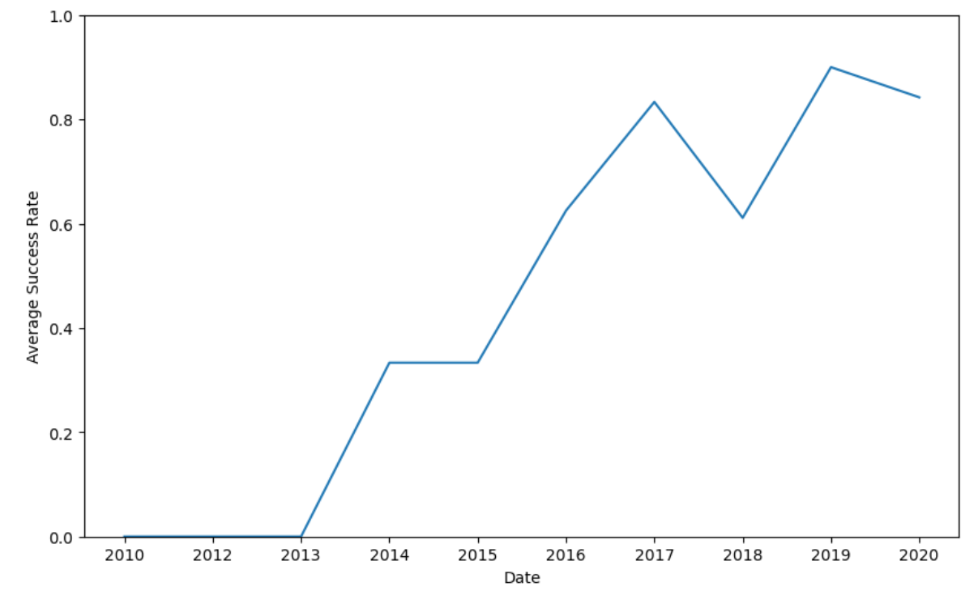
Launch Success Yearly Trend
Line chart of yearly average success rate
Analysis – there is a general trend of increasing success over the years, likely due to better technologies and greater refinement of the Falcon 9 design.

Slide 25
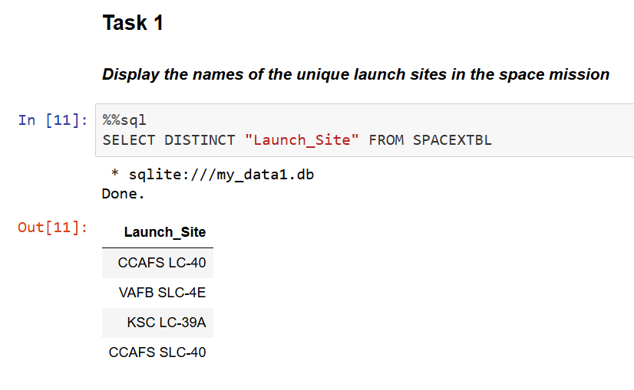
All Launch Site Names
Find the names of the unique launch sites
Result - SpaceX only uses 4 launch sites.

Slide 26
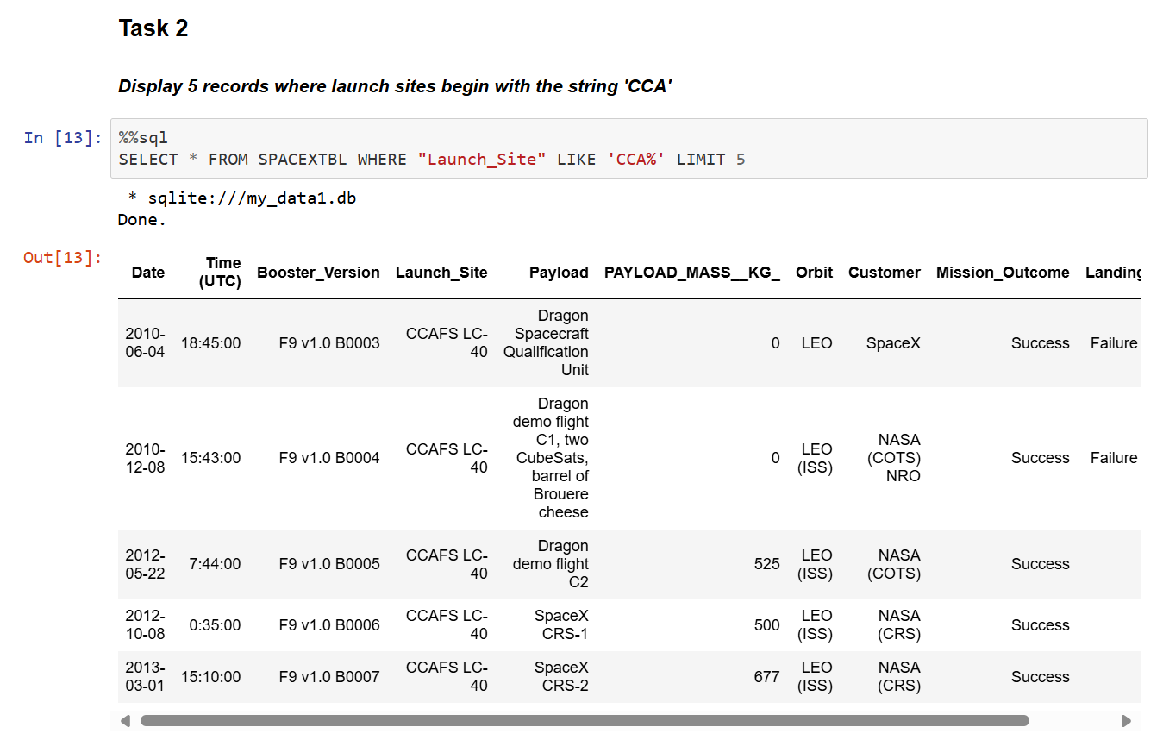
Launch Site Names Begin with 'CCA'
Find 5 records where launch sites begin with `CCA`
Result – nothing to comment on.

Slide 27
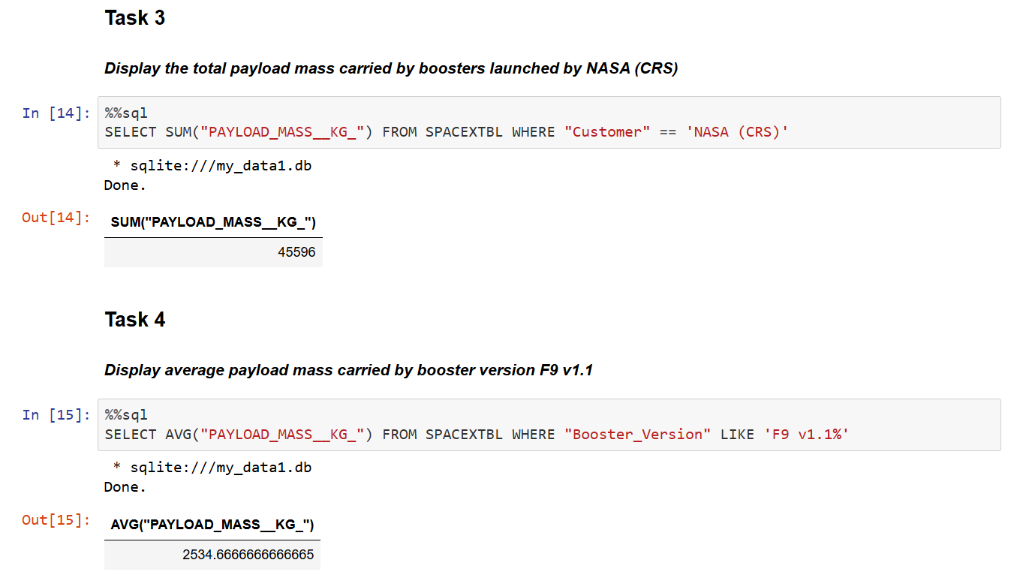
Total Payload Mass
Total payload carried by boosters from NASA
Result – nothing to comment on.

Slide 28
Average Payload Mass by F9 v1.1
Average payload mass carried by booster version F9 v1.1
Result – the F9 v1.1 carried smaller payloads

Slide 29
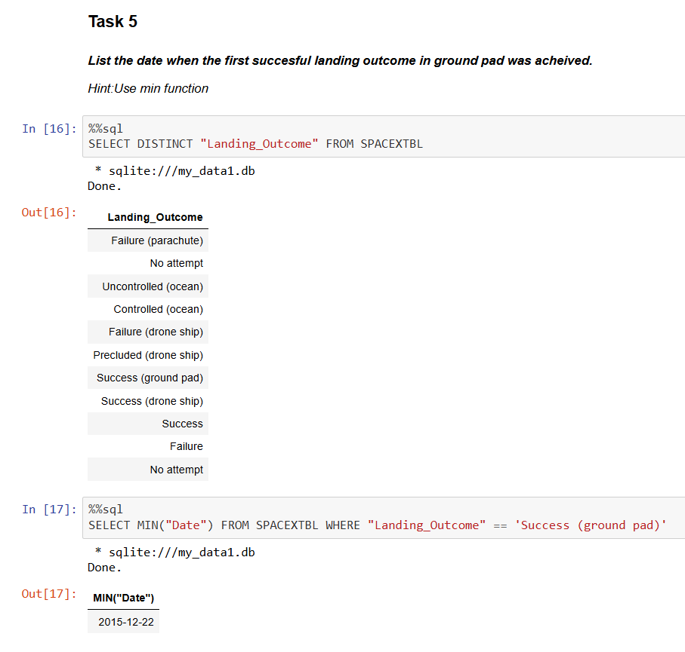
First Successful Ground Landing Date
Find the dates of the first successful landing outcome on ground pad
Result - the first successful landing outcome occurred on 22 Dec 2015

Slide 30
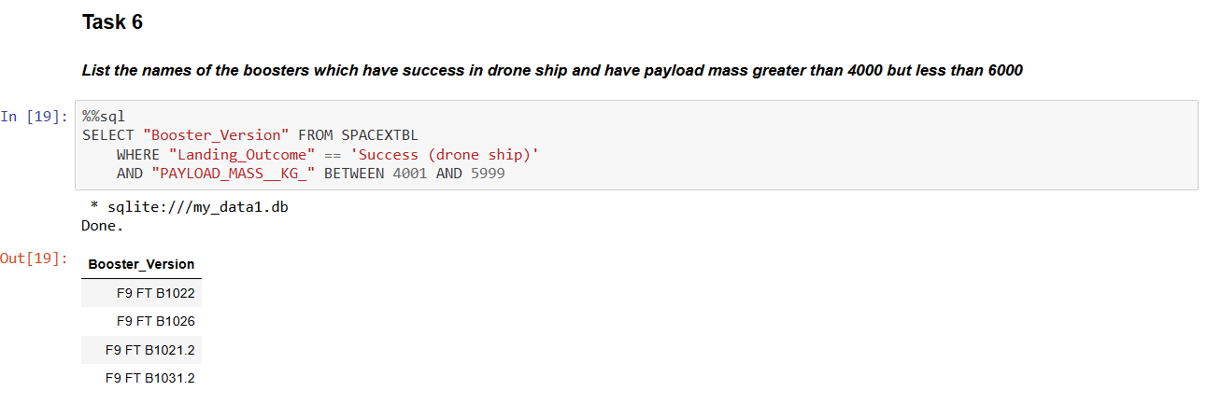
Successful Drone Ship Landing with Payload between 4000 and 6000
List the names of boosters which have successfully landed on drone ship and had payload mass greater than 4000 but less than 6000
Result – nothing to comment on

Slide 31
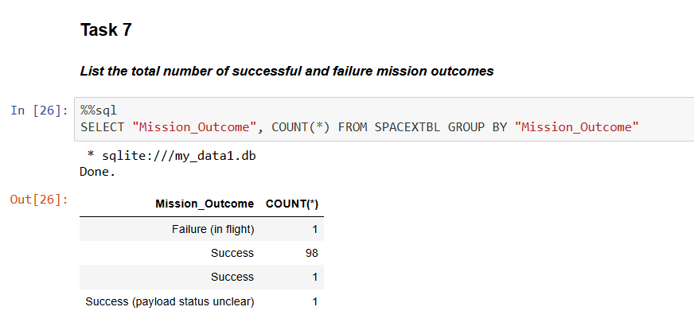
Total Number of Successful and Failure Mission Outcomes
Calculate the total number of successful and failure mission outcomes
Result – SpaceX has had a very high mission success rate. Landing outcomes are not considered in the success or failure of a mission.

Slide 32
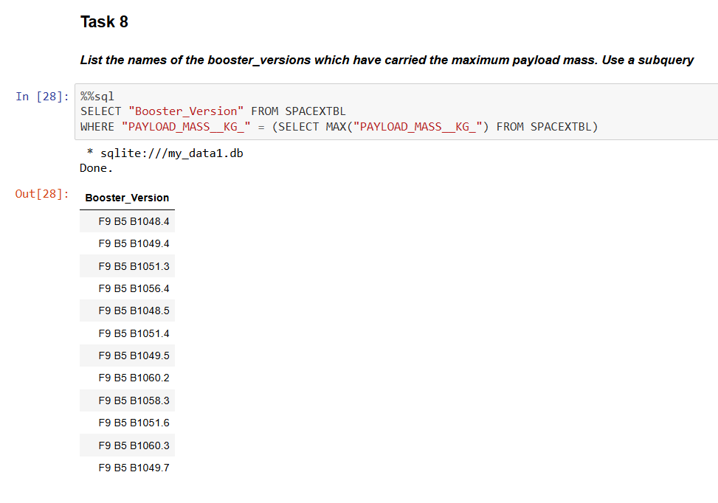
Boosters Carried Maximum Payload
List the names of the booster which have carried the maximum payload mass
Result – nothing to comment on.

Slide 33
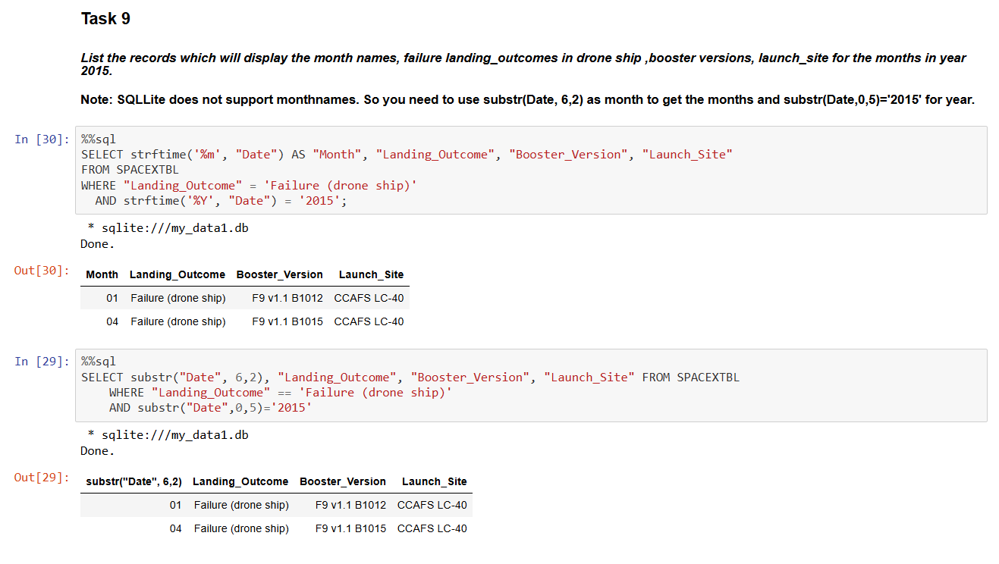
2015 Launch Records
List the failed landing_outcomes in drone ship, their booster versions, and launch site names for in year 2015
Result – nothing to comment on.

Slide 34
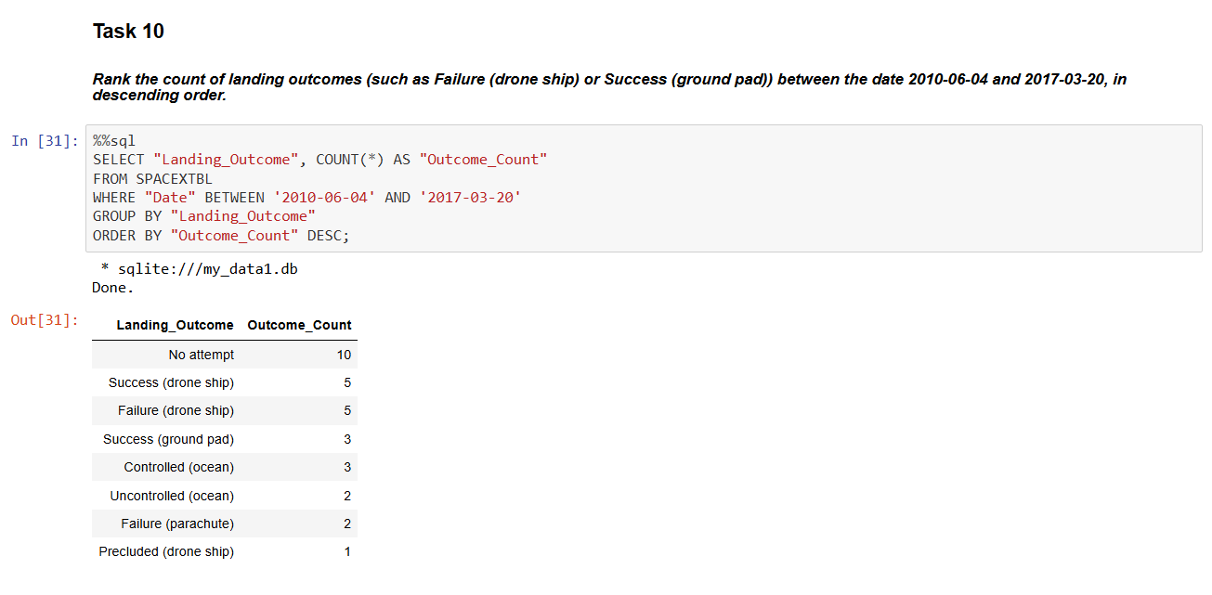
Rank Landing Outcomes Between 2010-06-04 and 2017-03-20
Rank the count of landing outcomes (such as Failure (drone ship) or Success (ground pad)) between the date 2010-06-04 and 2017-03-20, in descending order
Result – nothing to comment on.

Slide 35

Section 3

Slide 36
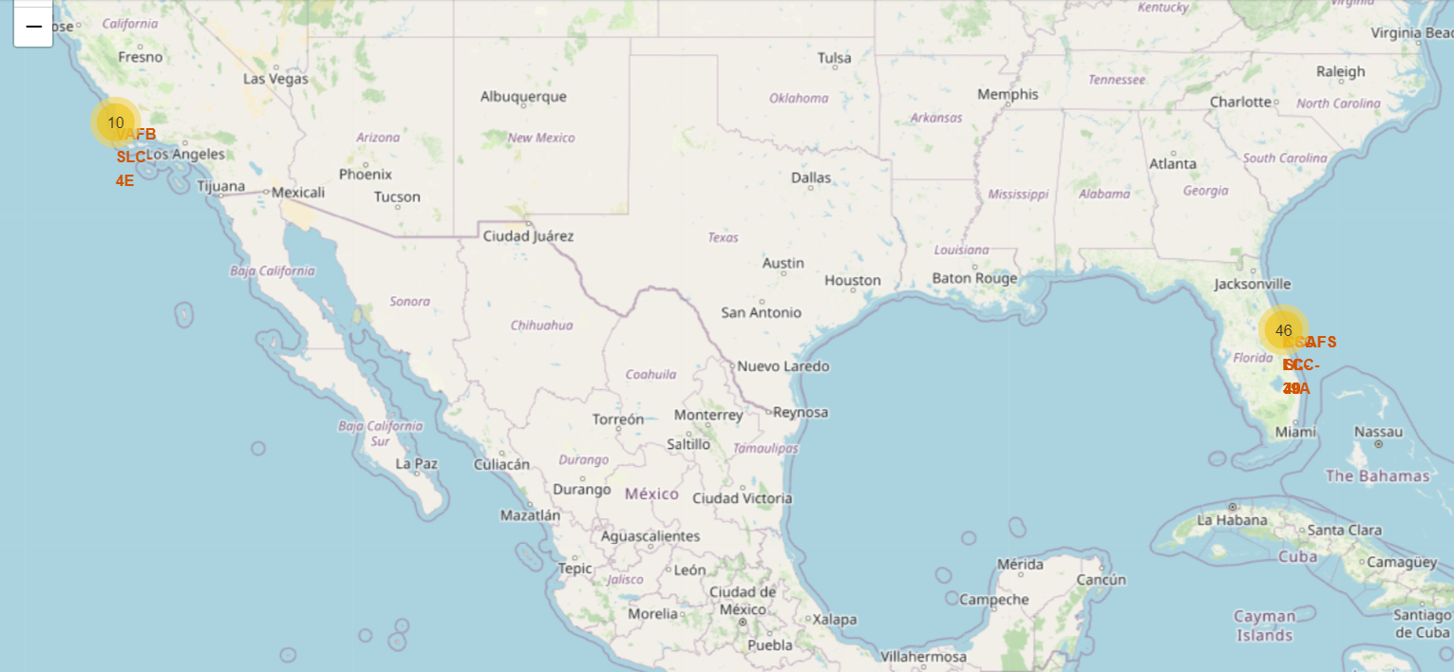
Map of SpaceX Launch Sites
SpaceX has chosen its 4 launch sites to be on the Western and Eastern coast, with 3 sites clustered close together on the Eastern coast.

Slide 37
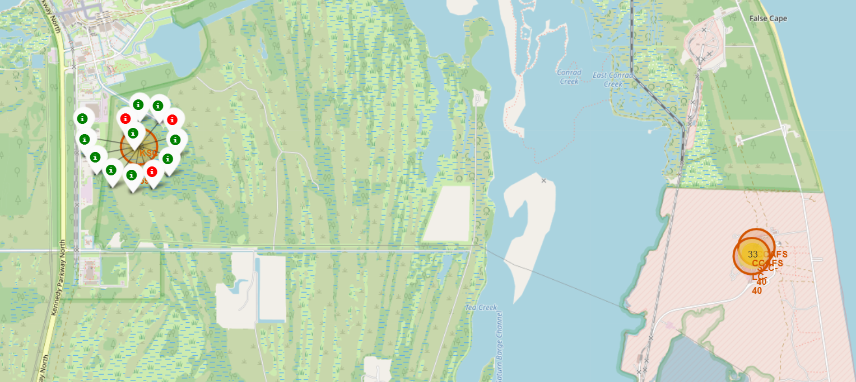
Close up of KSC LC-39A Launch Site with Launch Outcomes
Most missions have launched from launch sites on the Eastern coast, primarily at the CCAFS LC-40 and KSC LC-39A facilities.

Slide 38
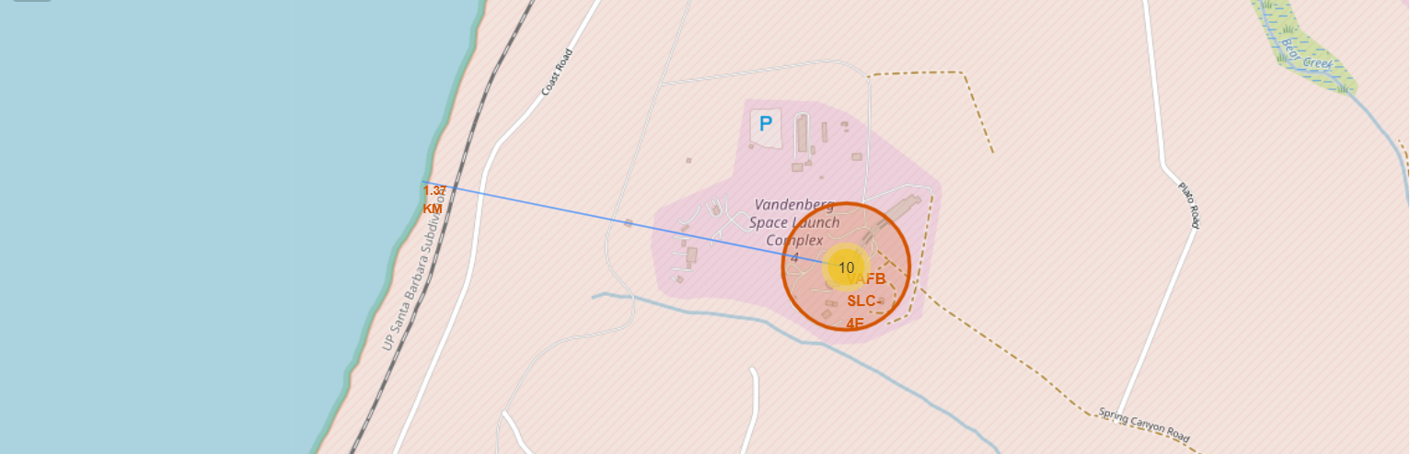
Close up of VAFB SLC-4E facility and surrounding features
SpaceX’s launch sites are all located close to the ocean (1.37km away, in this instance), for ocean landings and also for rockets to safely disintegrate in case missions go awry
Launch sites are also observed to be close to railways, highways, and airports – presumably for the easy transportation of personnel and rocket components
They are also situated far away from cities as a safety measure

Slide 39

Section 4

Slide 40
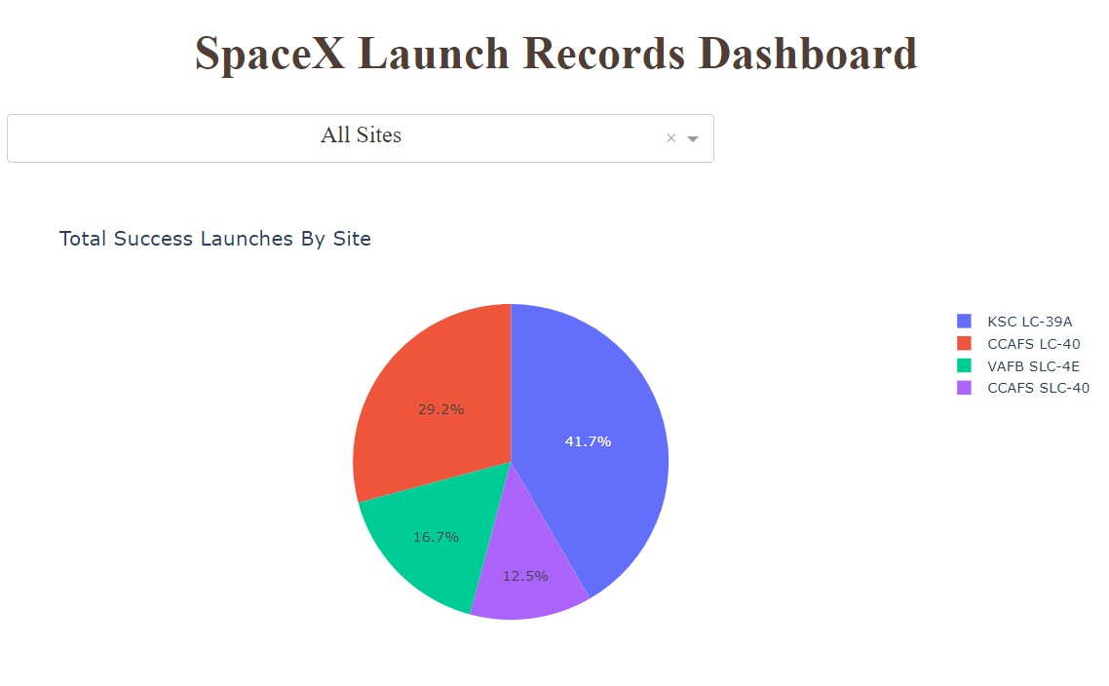
SpaceX Launch Records Dashboard Pt 1
The pie chart shows the landing success rate of SpaceX’s four launch sites
The site with highest rate of success is KSC LC-39A (41.7%) followed by CCAFS LC-40 (29.2%)
It is important to note that these sites also have markedly more launches than the others

Slide 41
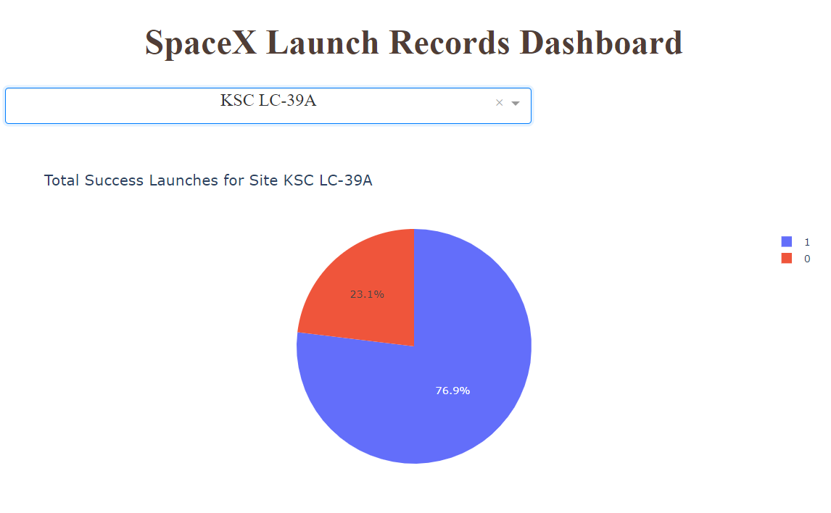
SpaceX Launch Records Dashboard Pt 2
The pie chart shows the landing success rate of the launch site with highest success rate, KSC LC-39A
76.9% of launches from this site have had successful landing outcomes

Slide 42
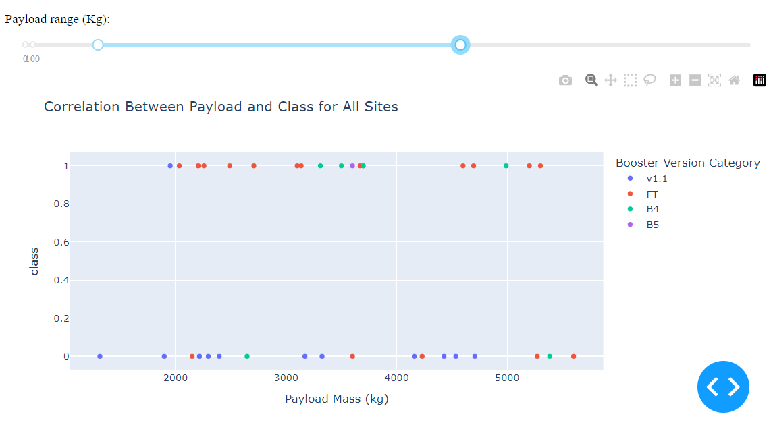
SpaceX Launch Records Dashboard Pt 3
The scatter point chart shows the relationship between Payload Mass, Booster Version and Success rate.
It is observed that most payloads fall within the selected range (~2000kg -~5500kg)
Payload does not seem to influence landing outcomes
However, ‘FT’ appears to be the best performing booster version across all payloads, and ‘v1.1’, the worst

Slide 43

Section 5

Slide 44
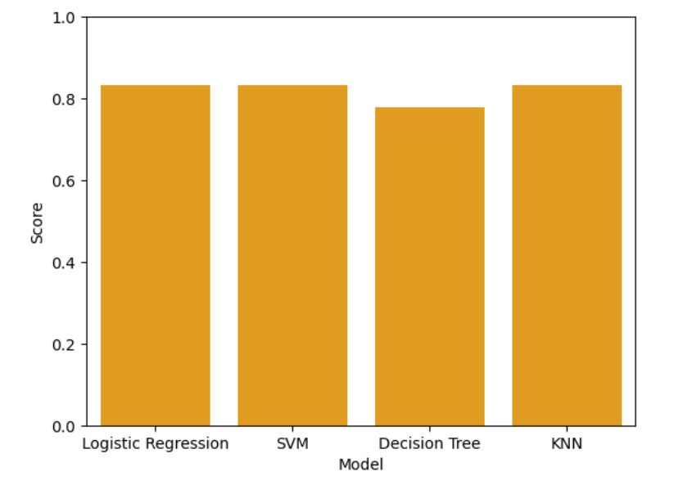
Classification Accuracy
Bar chart representing accuracy scores for all predictive models tested
The best performing classification models were Logistic regression, SVM, and KNN with equal accuracy scores of 0.833

Slide 45
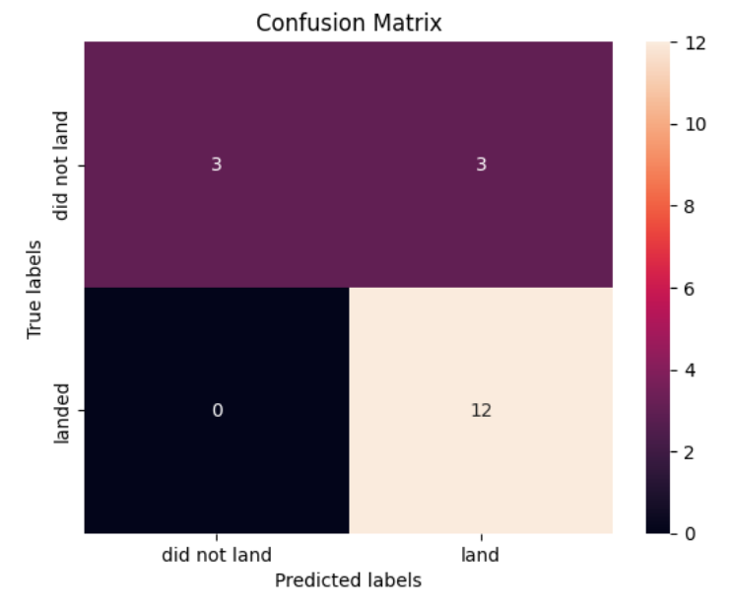
Confusion Matrix
Confusion matrix for Logistic regression, SVM, and KNN models
Out of the 6 unsuccessful landings, the models correctly predicted 3
Out of the 12 successful landings, the models correctly predicted 12

Slide 46
Conclusions
The one factor that influences landing outcomes the most is Flight Number. This makes sense as the more launches SpaceX makes, the better it gets at getting it right
Orbit type, Payload mass, and Booster version also somewhat influence the success rate of landings – however, the relationships are less straightforward. For instance, only certain orbits have a linear relationship with payload range and success
Launch sites have the least influence – the data is skewed to favor sites with more launches

Slide 47
Appendix
Include any relevant assets like Python code snippets, SQL queries, charts, Notebook outputs, or data sets that you may have created during this project

Slide 48


